Slide 1
Achieving Self-organizing Maps
on clustering analysis of temporal characteristics of car crashes
Status Report#2
The A Team

Slide 2
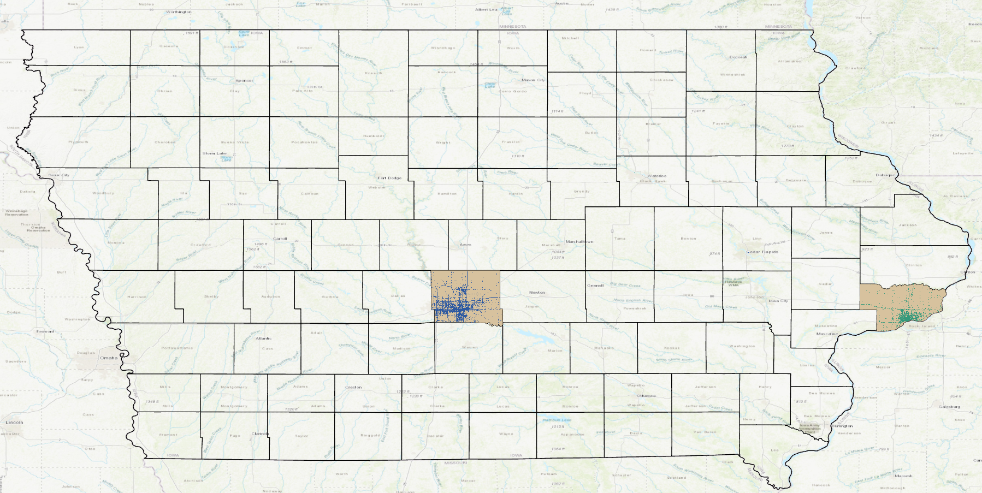
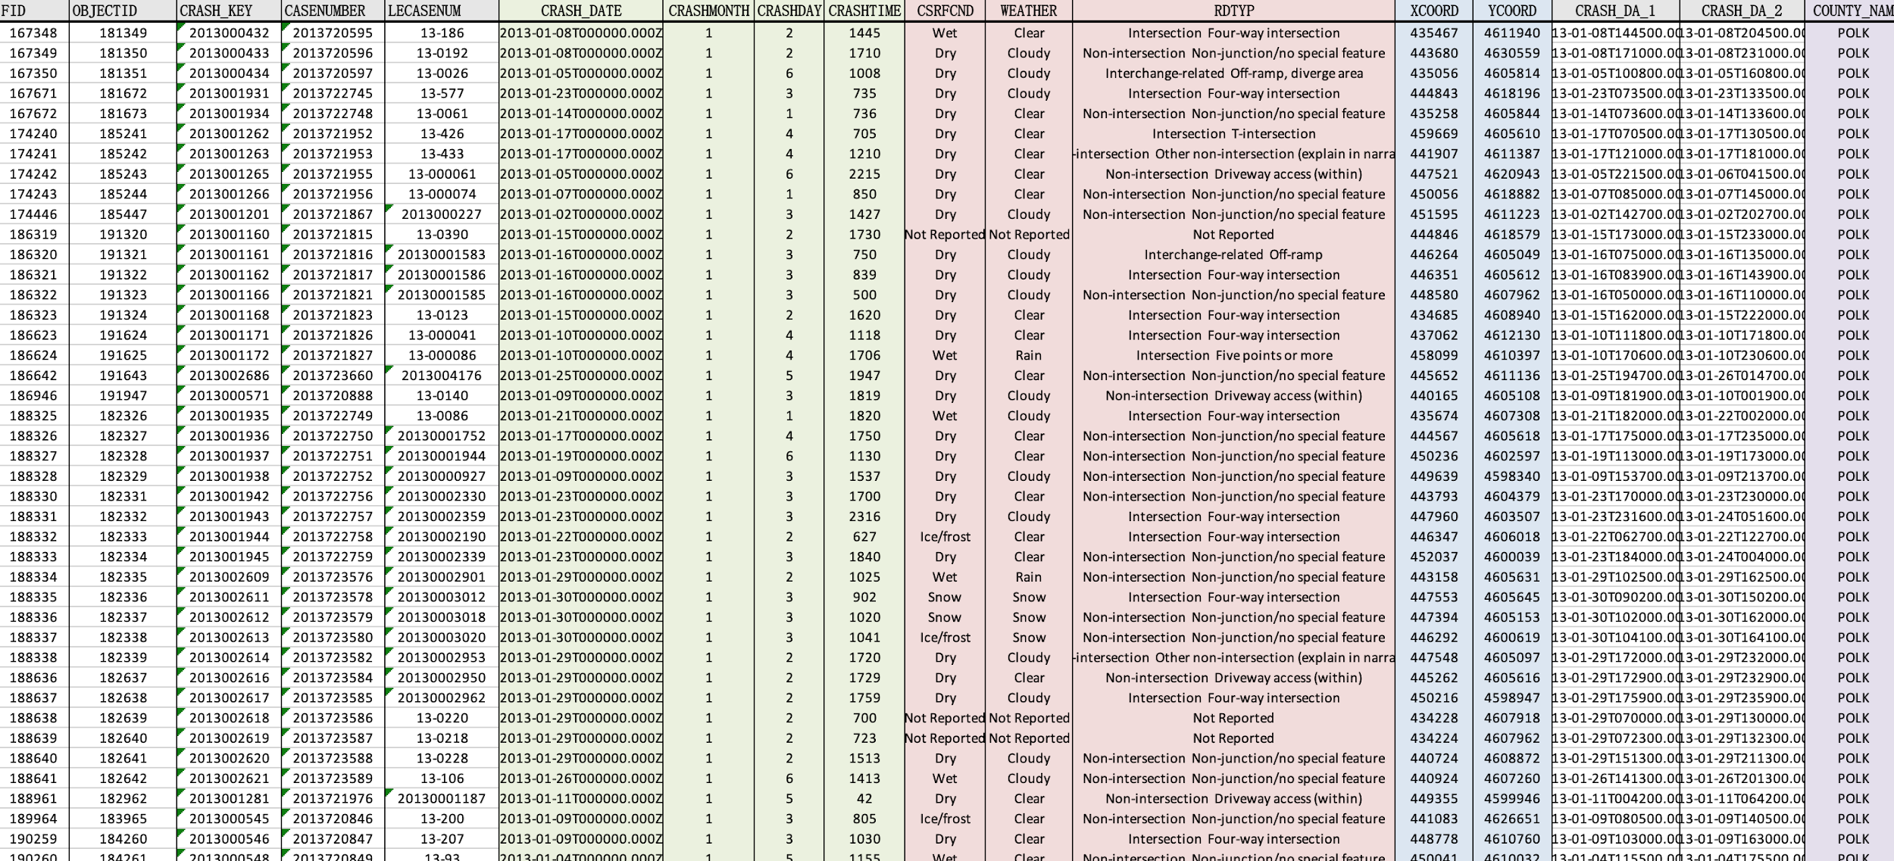
Basic Graphs
Polk County
(No.1 ranked in population)
Scott County
(No.3 ranked in population)
Notes:
The Excel Sheet we used and what we used within the excel sheet.
Gabriel
el Sheet we used and what we used within the excel sheet.
he cel Sheet we used and what we used within the excel sheet.

Slide 3
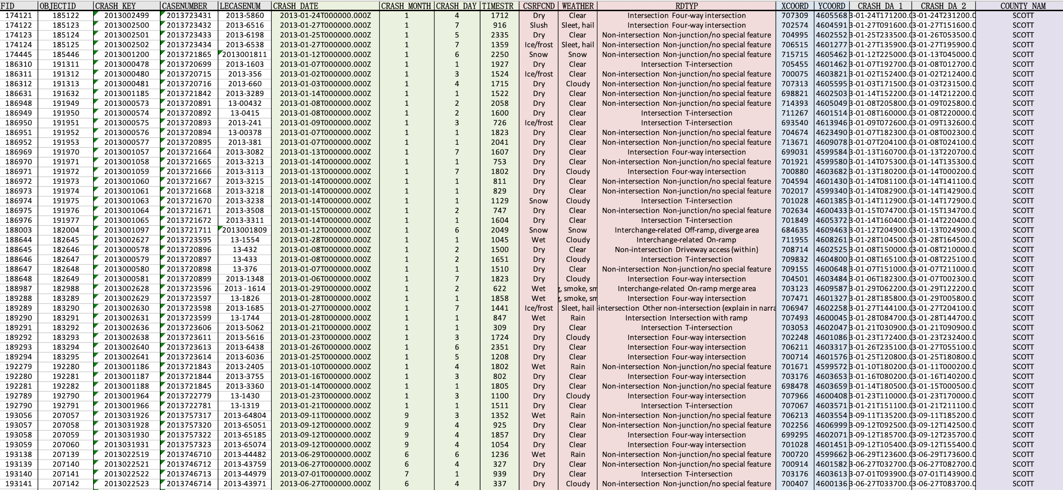
Notes:
The Excel Sheet we used and what we used within the excel sheet.
el Sheet we used and what we used within the excel sheet.
he cel Sheet we used and what we used within the excel sheet.

Slide 4
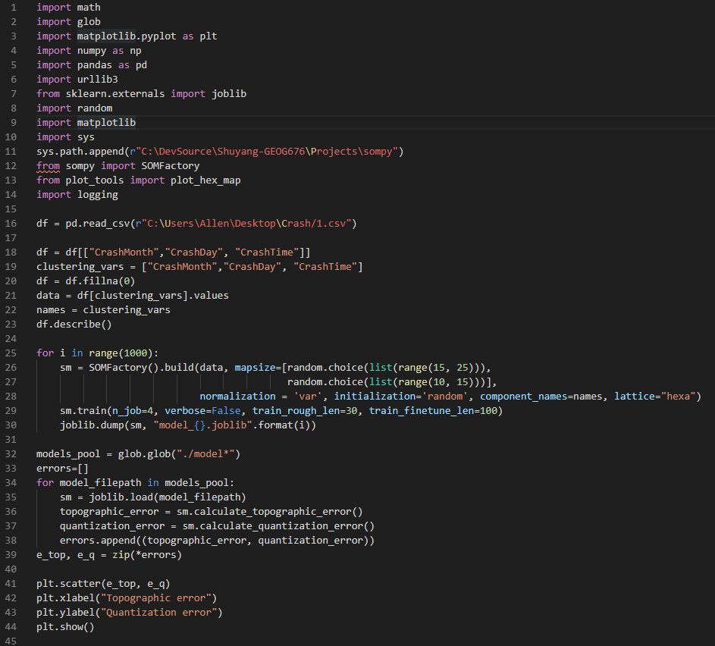
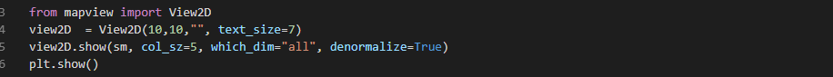
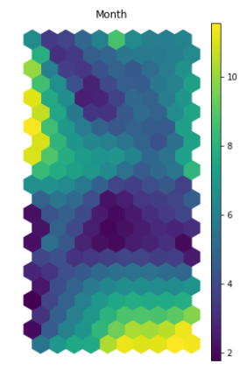
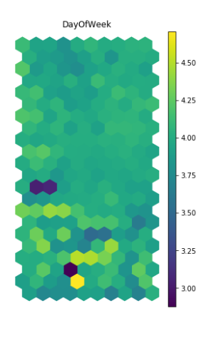
Code Explanation including Screenshots
Notes:
Presented by Shuyang

Slide 5
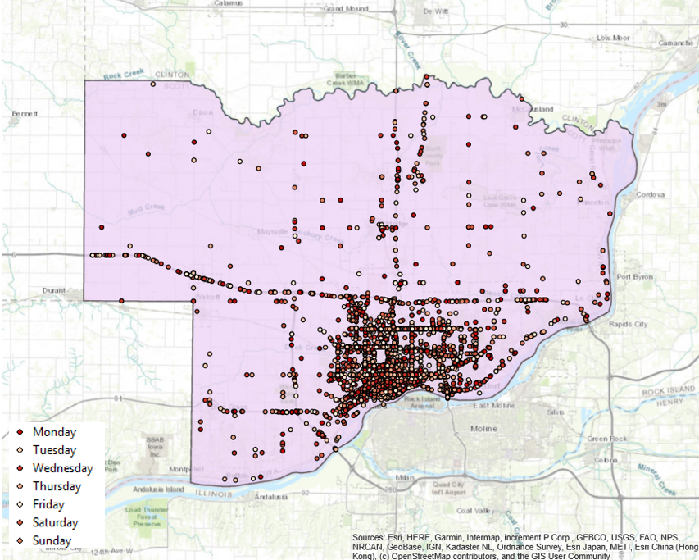

ArcMap Output
Scott County by day
Scott County by month
Notes:
Sapir

Slide 6
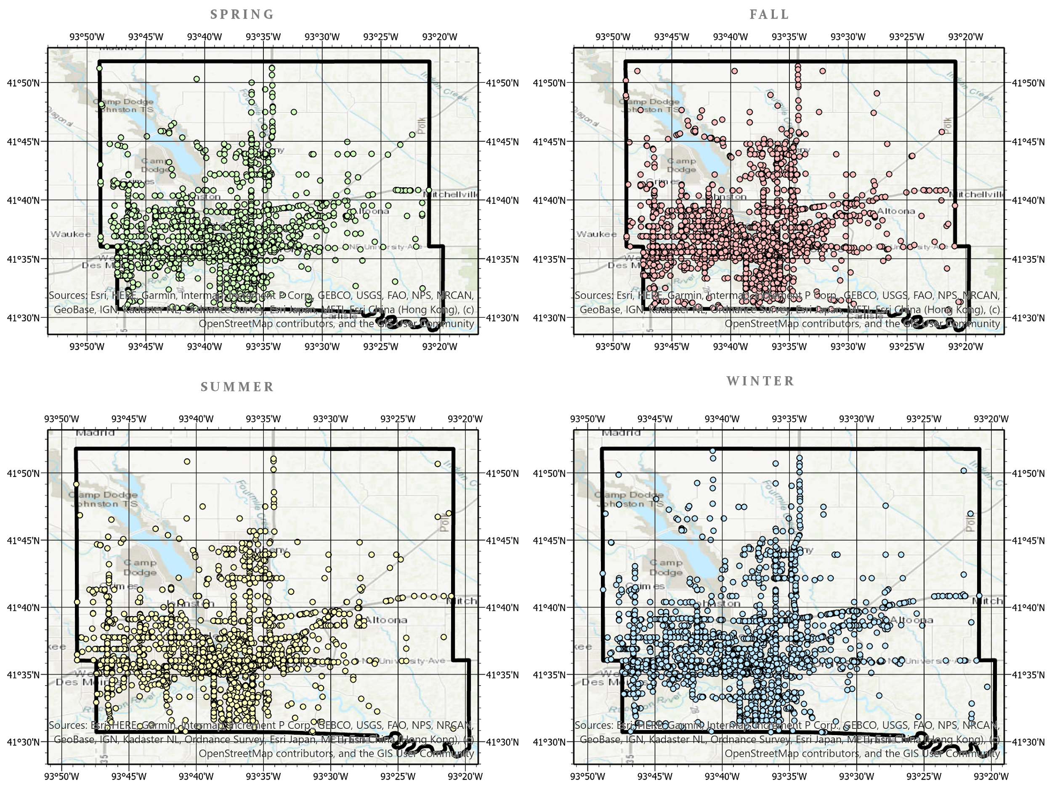
ArcMap Output
Polk County by Season

Slide 7
Why Significant?
The map shows the locations of the accidents and when they occur. The code helps display the temporal information lacking in the map.
Goal - ArcGIS toolbox or ArcGIS Online pop-up
This project is intended to help create a baseline for displaying in depth temporal data in GIS
Notes:
Presented by Arielle
What the Map shows & what the code output shows. Include explanation of why both are necessary.
Goal to create a toolbox or an AGOL project that displays temporal data
Creating a baseline for showing temporal data through GIS

Slide 8
Timeline:
Week 11 - Code finished
Week 12- Spatial And Temporal Graphs
Week 13 - Presentation finished and starting report
Week 13-15 - Finish final report
Notes:
Luke

Slide 9
Questions?

